Slide 1
House Price Regression Dataset Analysis

Slide 2
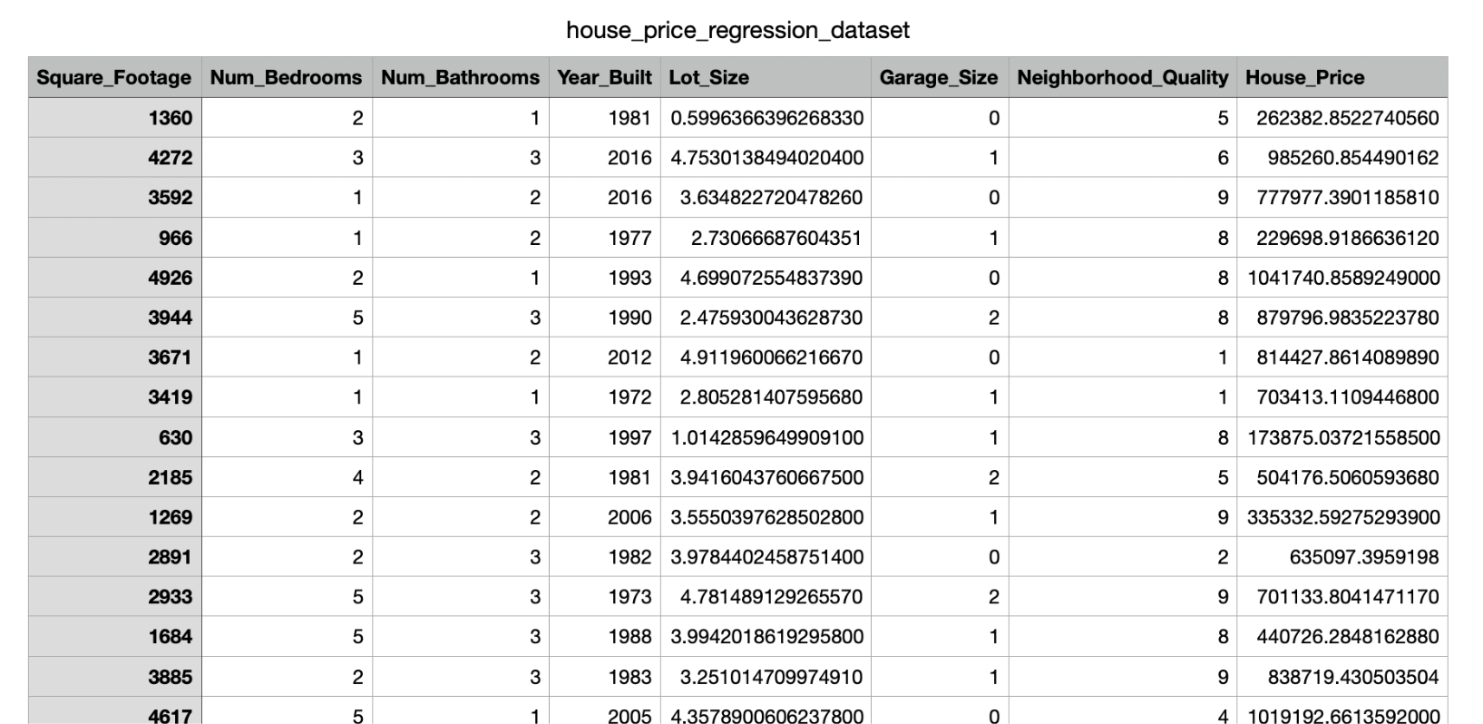
The Dataset

Slide 3
Why we chose this dataset?
Regression analysis : This model is ideal to investigate the relationship between a dependant variable (house price) and one or more independent variables (no. bedrooms, no.bathrooms, year, etc…)
Versatility: A regression model allows for predictive analytics (forecasting)
Relatability: The contents of the dataset can be understood to a range of people, across culture and education.
Many Variables: The dataset is large with are many variables that affect house price, creating a diverse and rich dataset, and allows for thorough comparison of many variables.
Notes:
Convey this in a way in simple terms, quick. Tackle visualisation for each slide. For understanding purposes,

Slide 4
What factors need to be improved?
No units of measurements: ‘house_price’, ‘lot_size’, and ‘square footage’ do not have labelled measurements.
Undefined rating system: Rating for neighbourhood is a 1-10 scale, but we are unaware of the criteria which determines this rating.
Blanks: There are blanks that need to be identified and filtered out.
Additional Data: If possible, include specific location data (e.g., city, proximity to schools or transport) to refine neighborhood quality insights, the types of bathrooms, type of garage…

Slide 5
House Price Regression Analysis
What can we analyse using the house_prices column?
Calculation Functions:
=AVG(H1:H1001), Average house price= 618,861.019
=MAX(H1:H1001), Maximum house price= 1,108,236.84,
= MIN(H1:H1001), Minimum house price =111,626.853,
= SUM(H1:H1001), Sum of all house prices= 618,861,018.65

Slide 6
Other Analysis:
Apply filters: We can apply filters that selects the data we want to use (houses built in 1950 and 2022 )
Create a pivot chart: This allows us to select functions such as COUNT, SUM, AVG.. which allows us to summarise the data we want to see.
Create graphs: Using the data selected we can use a line graph to look at how the price of housing varies by when the house was built.
Forecasting: From the trendline we can forecast what the price of houses will be in the future.

Slide 7
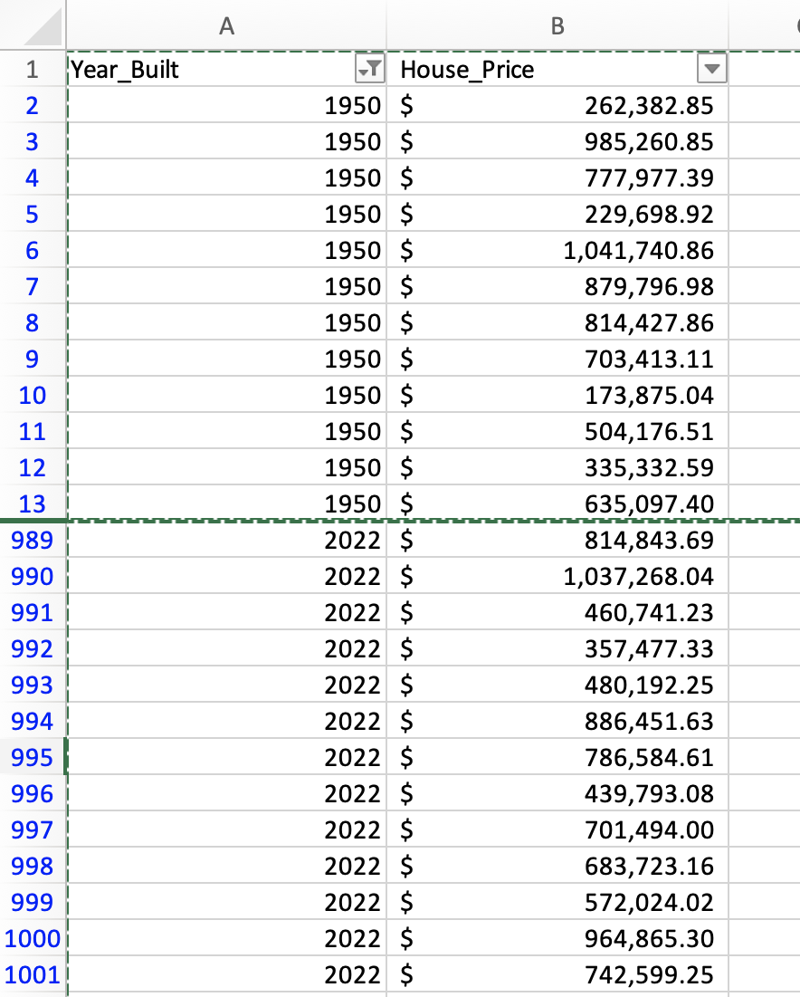
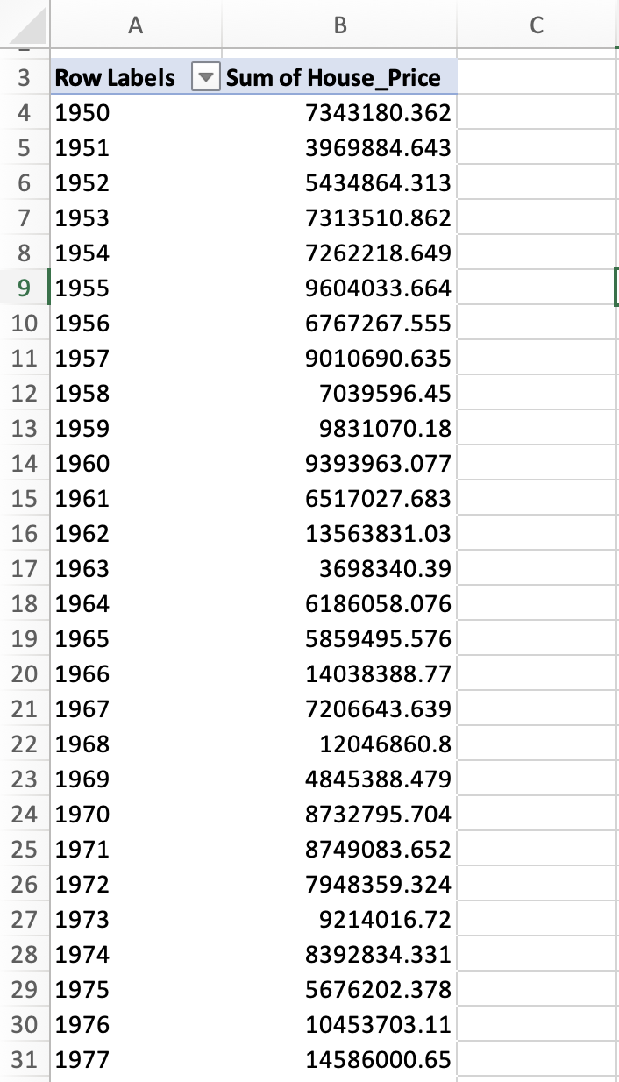
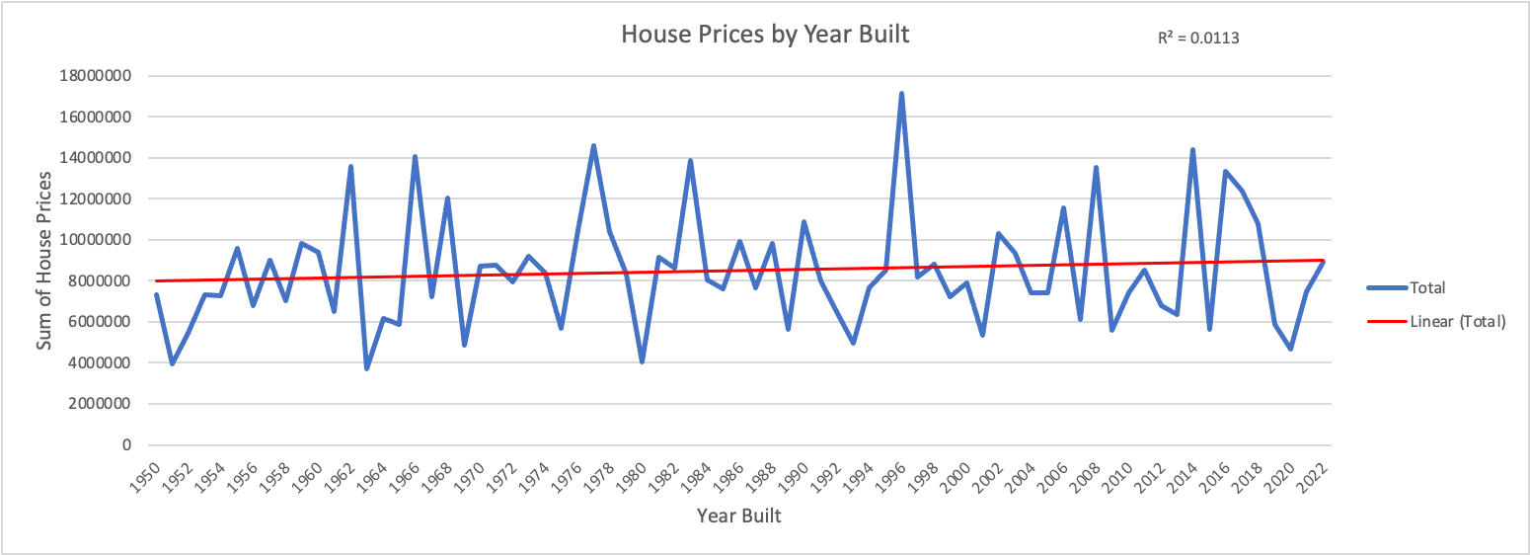
An example…
Filtered
Pivot Table
Trend prediction

Slide 8
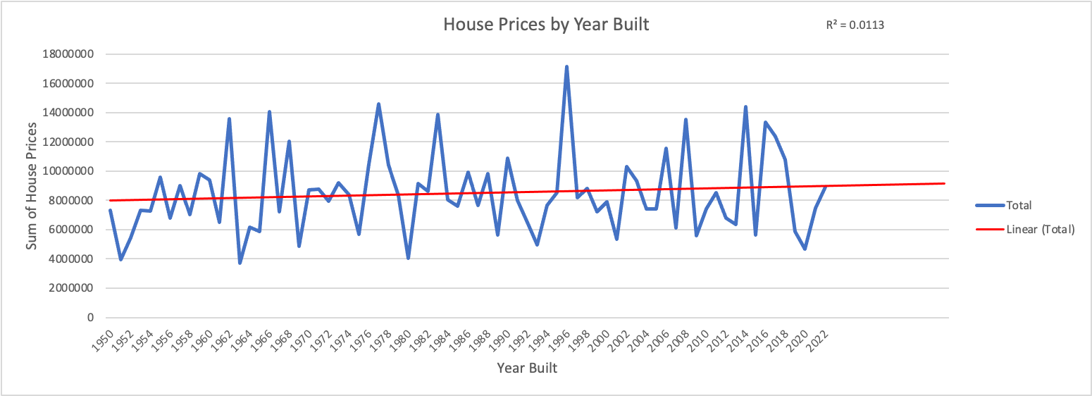
Forecast
This is a forecast model that predicts future trends in house prices.
We can see that sales increase over time.
This allows us to predict the best time to buy a house.

Slide 9
Garage Size
The numbers of cars was used to measure the garage size
The bigger the garage, the more expensive is the property.
Observation:
The garage size is not stated in actual plot measurement.
Instead of using number of cars, which is hard to determine as it depends on the particular size of cars they used, it would have been better to put the actual measurement of the garage size.
It was stated that houses with bigger garage are usually more expensive. The question now is, if garages are assumed to be measured by numbers of cars, how can the size of the garage be determined? It will be more realistic if the garage size is stated in measurements such as square foot.

Slide 10
Lots Size
The lots are measured in acres.
This feature is the major determinant of the cost of properties .
The bigger the lot, the higher the property price and the smaller the lot, the lower the property price.
.Observations:
The lots size is not well analysed to show how big or small it has become over the years in terms of number of rooms per house.
It is hard for one to use the datasets to decide the type of property in question. For example, is it terraced property, semi detached or detached houses.
It might help to show the average size of lots over the years which is 2.78 which will show that , the average lotscost is £618,861

Slide 11
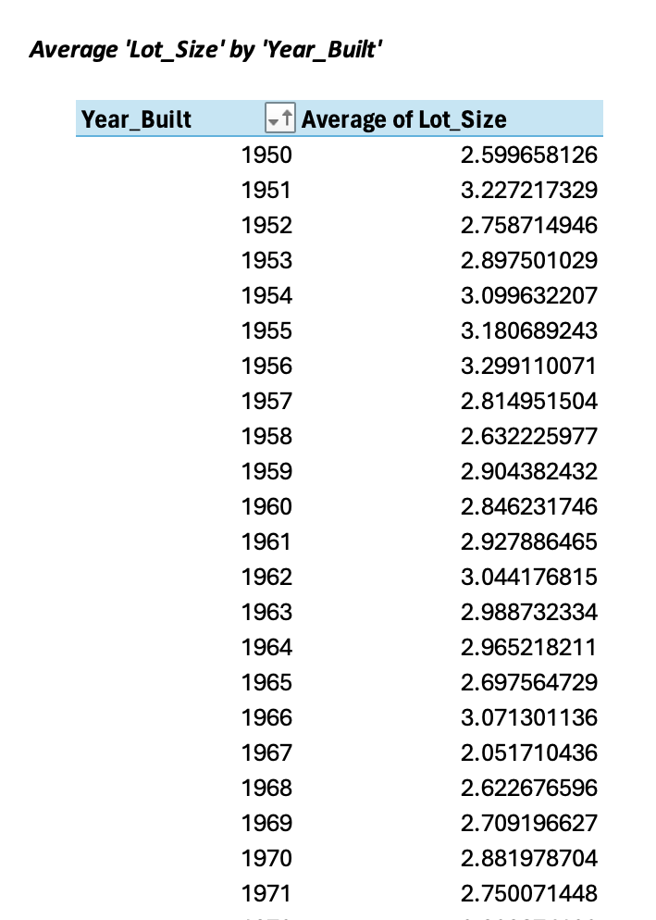
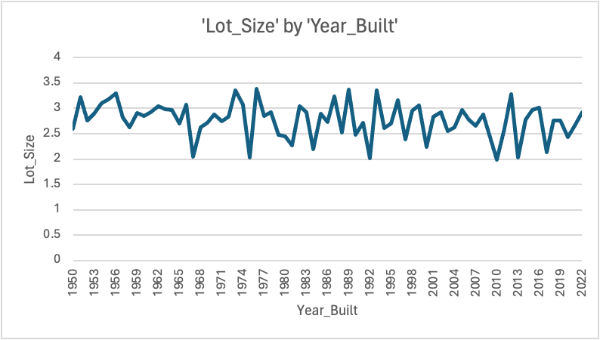
Lot Size by Year Built
Notes:
What does this mean? - what are we trying to visualise? Add a trendline- is it increasing/ decreasing presentation should have an aim. Lot

Slide 12
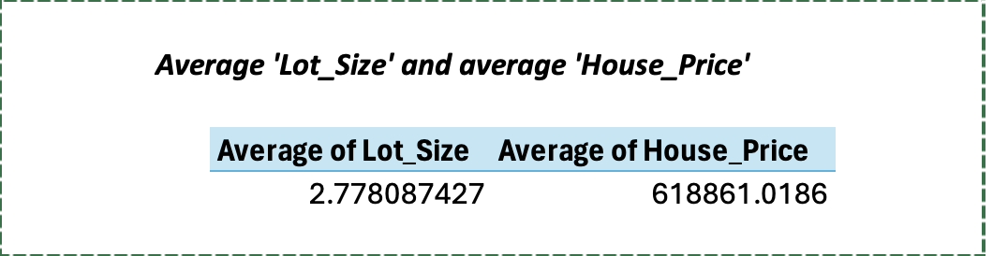
Average Lot Size and average House Price

Slide 13
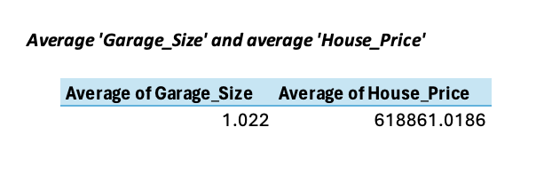
Average Garage Size and Average House Price

Slide 14
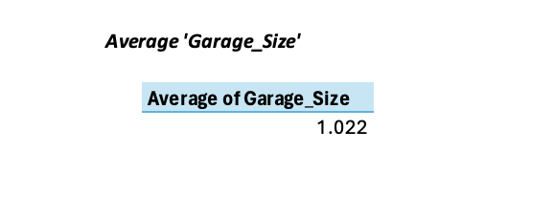
Average Garage Size

Slide 15
Bathrooms
The drawback here is that it merely lists the quantity of restrooms without describing their kind or characteristics. For example, it doesn't specify if each bathroom has a bathtub or shower or if it just has a washbasin and toilet.
Furthermore, it is not clear whether a bathroom is separate or en-suite. The accuracy of home price forecasts may be impacted by this lack of information because bathroom type and quality are crucial elements that have a big impact on property value.

Slide 16
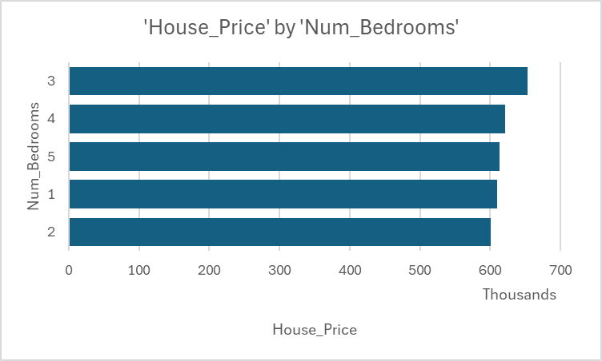
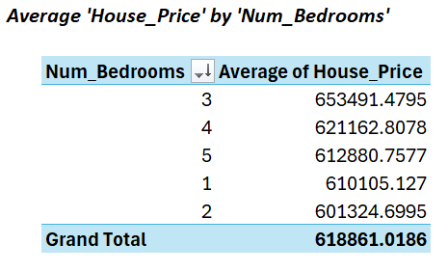
Bedrooms
The number of bedrooms in a house is a significant factor that influences its market price. Generally, houses with more bedrooms are valued higher due to their larger size and the increased utility they offer to potential buyers.
The bar chart illustrates the relationship between the number of bedrooms and house prices. Here are some key observations:
Higher Prices with More Bedrooms: Generally, houses with more bedrooms tend to have higher prices. This trend reflects the added value that extra bedrooms bring to a property.
Consistent Increase: The chart shows a steady increase in house prices as the number of bedrooms increases, indicating a clear positive correlation.
Market Dynamics: Buyers are typically willing to pay more for homes with additional bedrooms due to the increased living space and potential for accommodating larger families or guests.
This analysis highlights the importance of bedroom count as a significant factor in real estate pricing and can assist in making more informed decisions when evaluating properties.

Slide 17
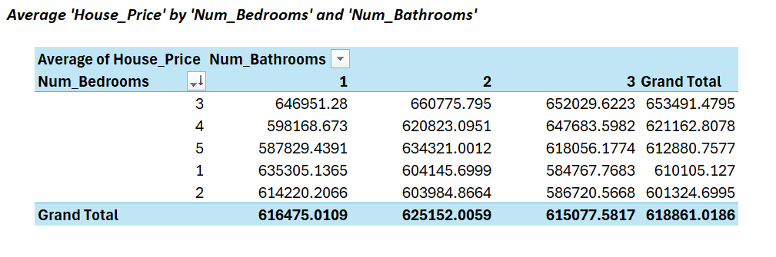
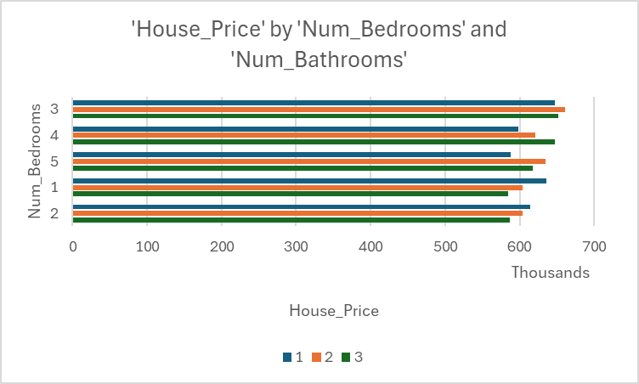

Slide 18
Square-footage Analysis
-The size of a house is measured in square feet. Larger homes typically have higher prices.
Square footage: This feature is highly correlated with house price meaning its a strong predictor of the price. Square footage ranges from 503 to 4,999 sq.ft , with a mean of about 2,815 sq.ft
The square footage of a house is a key driver of price so, no improvement is necessary for its a predictive power. However, the data has to be accurate in order calculate the right price for a house.
Visual Improvements
Visualising the relationship between square footage and house price via scatter plot, allows you to identify if there is a positive or negative linear relationship between square footage and house price. In this case there is a strong positive linear relationship between square footage and house price because as the square footage increases, the price also increases.
Correlation heatmap- helps you see the relationship between multiple variables in this dataset. In this case the square footage is highly correlated with the house price.

Slide 19
Neighbourhood quality
A rating of the neighborhood’s quality on a scale of 1-10, where 10 indicates a high quality neighborhood.
In this dataset the data for the neighbourhood quality has a wide spread ranging from 1-10 but it shows no significant relationship with price. 6 -10 seems to have slightly higher median house price compared to lower quality neighborhoods.
Further refinement is needed in this dataset for this column, such as grouping qualities into broader categories. Specially for future prediction on houses prices, identifying which areas are the high and low quality neighbourhoods is important because you can have homes in lower quality neighbourhood with a similar price tag as higher quality neighbourhoods.

Slide 20
Year Built
House prices have increased due to a combination of factors such as rising demand, population growth, limited housing supply, and urbanisation. Additionally, higher construction costs, land scarcity, and regulatory barriers contribute to price hikes.
However, prices can fluctuate due to inflation and economic conditions. Inflation reduces purchasing power, leading to increased house prices over time. During economic downturns or recessions, like the 2008 financial crisis, housing demand may decrease, causing prices to drop. Conversely, periods of economic growth can lead to price surges due to higher demand and consumer confidence..
Missing Information:
Renovations/Upgrades: Data on recent renovations could be valuable for more accurate price predictions.
Market Conditions: Include local market conditions (e.g., supply/demand) or economic factors (e.g., interest rates).
These improvements could provide a more holistic view of what influences house prices and offer more robust predictions.

